Slide 1
Scheduling (Part 3)
Roster Copy

Slide 2
Building a Roster
Training Overview
Copying a Roster

Slide 3
The Roster Setup tool should only be used BEFORE a Course Section begins. If a student needs to be removed from the section or added to a section after the term start date or the student ended enrollment in the school and has since returned, use Walk-In Scheduler
Manually Add Students to the Section
Select students to move into the section by clicking on their name in the right hand column. Their name will then be displayed in the Current Roster column.
Click the Save Student List and/or Copy Section icon when finished.

Slide 4
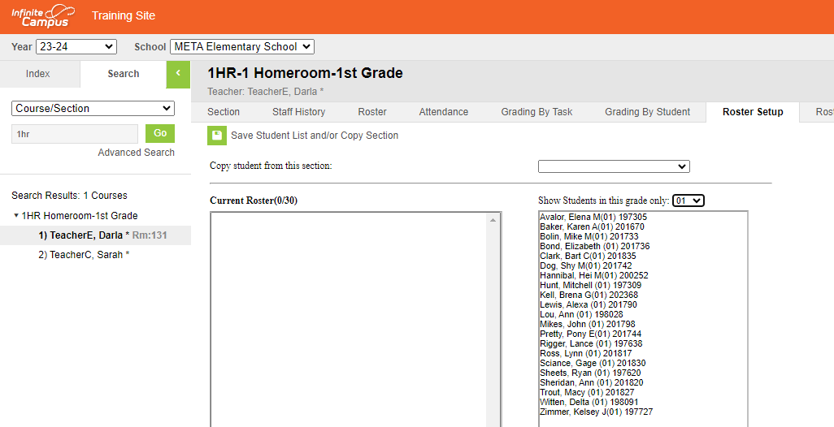
Classic Look
Verify the Year and School selected
Search Course/Section
Limit student list by selecting grade level
Select the first section to build

Slide 5
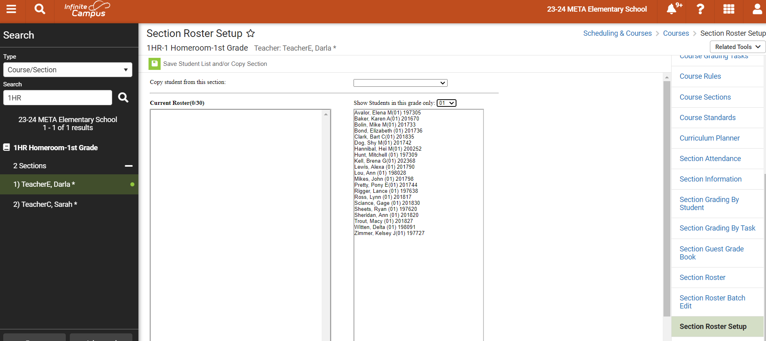
New Look

Slide 6
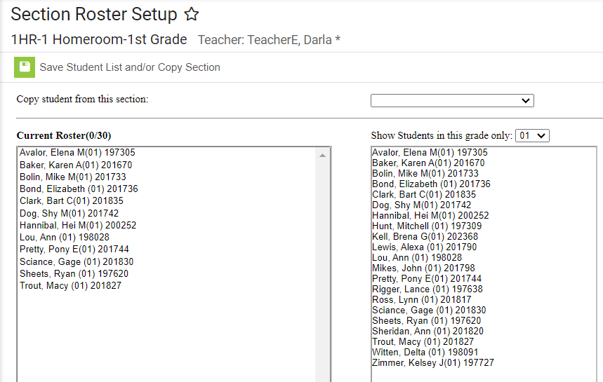
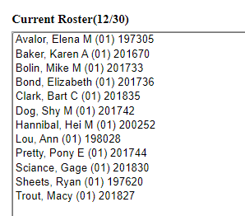
Current Roster will only show a total after being saved
Student names do not come out of selection list when they are placed in the roster

Slide 7
The Roster Setup tool should only be used BEFORE a Course Section begins. If a student needs to be removed from the section or added to a section after the term start date or the student ended enrollment in the school and has since returned, use Walk-In Scheduler
Copy Students from an Existing Section
Select the course to copy students into
Select from the dropdown list the section to copy students from
Click the Save Student List and/or Copy Section

Slide 8
Classic Look
Search Course/Section
Select the section to copy into
Note that the Roster doesn’t appear in either student list box until after clicking the Save Student List and/or Copy Section icon

Slide 9
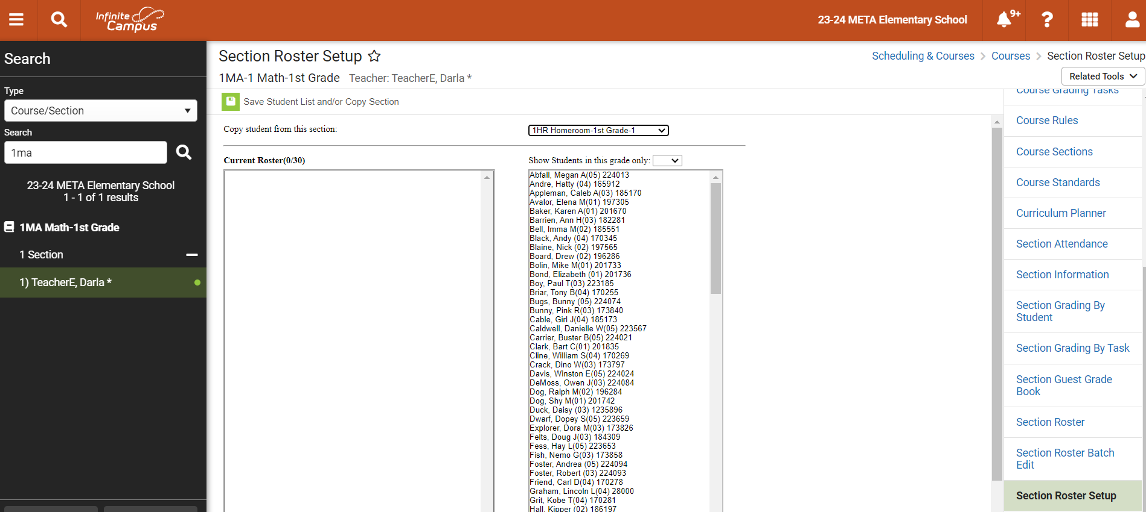
New Look

Slide 10
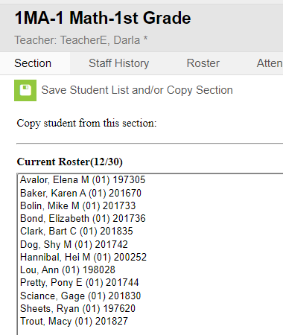
After clicking the Save Student List and/or Copy Section icon, the Current Roster box will populate
Complete this step for each course/each grade level

Slide 11
Do you have homerooms or are
you using a course in place of
homeroom?
Do you have enough sections of
each course?
Do the section numbers match
for each grade level course?
Are the Primary Teachers
correct?
Have all students been assigned?
Things to watch for

Slide 12
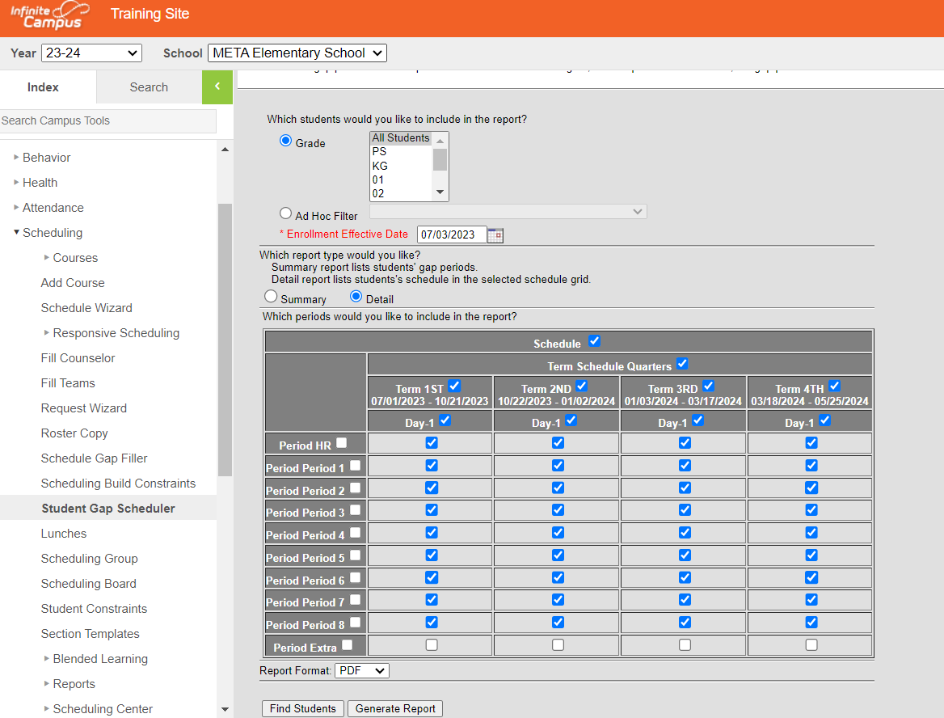
Report to verify all students have been placed in courses
Scheduling>Student Gap Scheduler
Enrollment effective Date needs to be your first day of school
Unselect any period that is not a scheduled period
Selecting Find Students will list students in the index and selecting Generate Report will produce a report you can print

